Slide 1
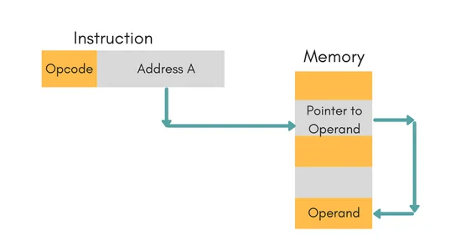
ADDRESSING MODES OF 8086
Prepared by
Subhasish Das
Assistant Professor
Electrical Engineering Department
B.P. Poddar Institute Of Management & Technology

Slide 2
Types of addressing mode in 8086
Register Addressing
Immediate Addressing
Direct Addressing
Register Indirect Addressing
Based Addressing
Indexed Addressing
Based Index Addressing
String Addressing
Direct I/O port Addressing
Indirect I/O port Addressing
Relative Addressing
Implied Addressing

Slide 3
Register Addressing mode
The instruction will specify the name of the register which holds the data to be operated by the instruction.
Example:
MOV CL, DH
MOV BX,AX
The content of 8-bit register DH is moved to another 8-bit register CL
AX
3F | 29
BX
DH
CL
3F | 29
2A
2A

Slide 4
Immediate Addressing mode
In immediate addressing mode, an 8-bit or 16-bit data is specified as part of the instruction
Example:
MOV DL, 08H
The 8-bit data (08_{H}) given in the instruction is moved to DL
(DL) ← 08_{H}
MOV AX, 0A9FH
The 16-bit data (0A9F_{H}) given in the instruction is moved to AX register
(AX) ← 0A9F_{H}
AH
AL
0A 9F
AX

Slide 5
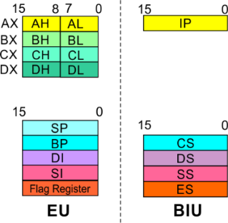
Addressing Modes : Memory Access
Offset Value (16 bits)
Segment Register (16 bits)
0 0 0 0
Adder
Physical Address (20 Bits)

Slide 6
Physical Address Calculation
20 Address lines ⇒ 8086 can address up to 2²⁰ = 1M bytes of memory
However, the largest register is only 16 bits.Physical Address will have to be calculated
Physical Address : Actual address of a byte in memory. i.e. the value which goes out onto the address bus.
Memory Address represented in the form – Seg : Offset (Eg - 9000:2400)
Each time the processor wants to access memory, it takes the contents of a segment register, shifts it one hexadecimal place to the left (same as multiplying by 16₁₀), then add the required offset to form the 20- bit address
9000 : 2400 → 9000 → 90000 (Paragraph to byte → 9000 x 10 = 90000)
2400 → 02400 (Offset is already in byte unit)
+ -------
92400 (The absolute address)

Slide 7
To access memory we use these four registers: BX, SI, DI, BP Combining these registers inside [ ] symbols, we can get different memory locations (Effective Address, EA)
[BX + SI] [BX + DI] [BP + SI] [BP + DI] | [SI] [DI] d16 (variable offset only) [BX] | [BX + SI + d8] [BX + DI + d8] [BP + SI + d8] [BP + DI + d8]
[SI + d8] [DI + d8] [BP + d8] [BX + d8] | [BX + SI + d16] [BX + DI + d16] [BP + SI + d16] [BP + DI + d16] | [SI + d16] [DI + d16] [BP + d16] [BX + d16]
BX BP | SI DI | + disp

Slide 8
Direct Addressing
Here, the effective address of the memory location at which the data operand is stored is given in the instruction.
The effective address is just a 16-bit number written directly in the instruction.
Example:
MOV BX, [1354H]
MOV BL, [0400H]
The square brackets around the 1354_{H} denotes the contents of the memory location. When executed, this instruction will copy the contents of the memory location into BX register.
This addressing mode is called direct because the displacement of the operand from the segment base is specified directly in the instruction.

Slide 9
Register Indirect Addressing
In Register indirect addressing, name of the register which holds the effective address (EA) will be specified in the instruction.
Registers used to hold EA are any of the following registers: BX, BP, DI and SI.
Content of the DS register is used for base address calculation.
Example:
MOV CX, [BX]
Operations:
EA = (BX)
BA = (DS) x 16₁₀
MA = BA + EA
(CX) ← (MA) or,
(CL) ← (MA)
(CH) ← (MA +1)

Slide 10
Based Addressing
In Based Addressing, BX or BP is used to hold the base value for effective address and a signed 8-bit or unsigned 16-bit displacement will be specified in the instruction.
In case of 8-bit displacement, it is sign extended to 16-bit before adding to the base value.
When BX holds the base value of EA, 20-bit physical address is calculated from BX and DS.
When BP holds the base value of EA, BP and SS is used.
Example:
MOV AX, [BX + 08H]
Operations:
0008_{H} ← 08_{H} (Sign extended)
EA = (BX) + 0008_{H}
BA = (DS) x 16₁₀
MA = BA + EA
(AX) ← (MA) or,
(AL) ← (MA)
(AH) ← (MA + 1)

Slide 11
Indexed Addressing
SI or DI register is used to hold an index value for memory data and a signed 8-bit or unsigned 16-bit displacement will be specified in the instruction.
Displacement is added to the index value in SI or DI register to obtain the EA.
In case of 8-bit displacement, it is sign extended to 16-bit before adding to the base value.
Example:
MOV CX, [SI + A2H]
Operations:
00A2_{H} ← A2_{H} (Sign extended)
EA = (SI) + 00A2_{H}
BA = (DS) x 16₁₀
MA = BA + EA
(CX) ← (MA) or,
(CL) ← (MA)
(CH) ← (MA + 1)

Slide 12
Based Index Addressing
In Based Index Addressing, the effective address is computed from the sum of a base register (BX or BP), an index register (SI or DI) and a displacement.
Example:
MOV DX, [BX + SI + 0AH]
Operations:
000A_{H} ← 0A_{H} (Sign extended)
EA = (BX) + (SI) + 000A_{H}
BA = (DS) x 16₁₀
MA = BA + EA
(DX) ← (MA) or,
(DL) ← (MA)
(DH) ← (MA + 1)

Slide 13
String Addressing
Employed in string operations to operate on string data.
The effective address (EA) of source data is stored in SI register and the EA of destination is stored in DI register.
Segment register for calculating base address of source data is DS and that of the destination data is ES.
Example: MOVS BYTE
Operations:
Calculation of source memory location:
EA = (SI) BA = (DS) x 16₁₀ MA = BA + EA
Calculation of destination memory location:
EA_{E} = (DI) BA_{E} = (ES) x 16₁₀ MA_{E} = BA_{E} + EA_{E}
(MA_{E}) = (MA)
If DF = 1, then (SI) =(SI) – 1 and (DI) = (DI) - 1
If DF = 0, then (SI) =(SI) +1 and (DI) = (DI) + 1

Slide 14
Port Addressing
These addressing modes are used to access data from standard I/O mapped devices or ports.
In direct port addressing mode, an 8-bit port address is directly specified in the instruction.
Example: IN AL, [09H]
Operations: PORT_{addr} = 09_{H}
(AL) ← (PORT)
Content of port with address 09_{H} is moved to AL register
In indirect port addressing mode, the instruction will specify the name of the register which holds the port address. In 8086, the 16-bit port address is stored in the DX register.
Example: OUT [DX], AX
Operations: PORT_{addr} = (DX)
(PORT) ← (AX)
Content of AX is moved to port whose address is specified by DX register.

Slide 15
Relative Addressing
In this addressing mode, the effective address of a program instruction is specified relative to Instruction Pointer (IP) by an 8-bit signed displacement.
Example: JZ 0AH
Operations:
000A_{H} ← 0A_{H} (sign extend)
If ZF = 1, then
EA = (IP) + 000A_{H}
BA = (CS) x 16₁₀
MA = BA + EA
If ZF = 1, then the program control jumps to new address calculated above.
If ZF = 0, then next instruction of the program is executed.

Slide 16
Implied Addressing
Instructions using this mode have no operands. The instruction itself will specify the data to be operated by the instruction.
Example: CLC
This clears the carry flag to zero.

